Slide 1

Case DSL – Julian Derks
Predicting de nightly price of a new listing for airbnb

Slide 2
Overview
Scoping the problem
Manual feature selection (1)
Data pre-processing
Data exploration
Modeling
Initial evaluation
Feature selection (2)
Final evaluation
Future steps

Slide 3
Scoping the problem
Predicting de nightly price of a new listing for airbnb
We want to deliver a regression model that can help and advice NEW hosts with their NEW listing on the nightly price
Assumptions
No historical data of host nor listing will be available
No other price indicator variables are available as the host also has no idea for these values
For example: security deposit, price for extra persons, etc.

Slide 4
Manual Feature selection

Slide 5
Manual feature selection
Drop columns which we assume to be unavailable in a practical setting
Historical listing / host data
E.g., number_of_reviews, review_scores_rating, host_acceptance_rate, ...
Any other price related column for the listing
E.g., weekly_price, cleaning_fee, extra_people, ...
Drop columns which we assume to be useless for prediction. Using our common sense.
E.g., host_picture_url, listing_url, host_thumbnail_url, ...
Drop the text columns that would take to long to transform in given timeframe (would need to dive into NLP)
E.g., neighborhood_overview, description, notes, ...
Select most relevant/(clean) geographical features
I.e., "latitude", "longitude“, “neighbourhood_cleansed”, “neighbourhood_group_cleansed”

Slide 6
Remaining features
Data shape - Before:(22552, 96) --> After:(22552, 27)
Features
'experiences_offered', 'host_identity_verified', 'neighbourhood_cleansed', 'neighbourhood_group_cleansed', 'latitude', 'longitude', 'property_type', 'room_type', 'accommodates', 'bathrooms', 'bedrooms', 'beds', 'bed_type', 'amenities', 'square_feet', 'price', 'guests_included', 'minimum_nights', 'maximum_nights', 'requires_license', 'license', 'jurisdiction_names', 'instant_bookable', 'is_business_travel_ready', 'cancellation_policy', 'require_guest_profile_picture', 'require_guest_phone_verification'

Slide 7
Data preprocessing
Checking, Cleaning and Transforming individual columns

Slide 8
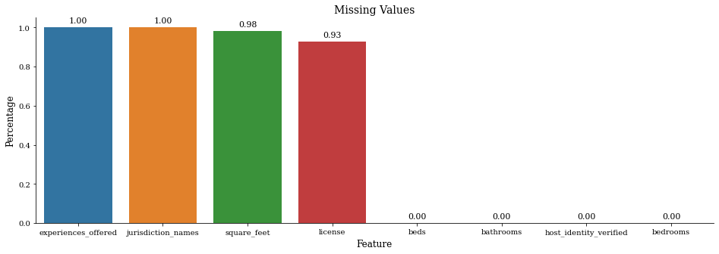
Missing Values
Drop features with > 90% missing.
Replace missing values of remaining features (i.e., the median/mode).

Slide 9
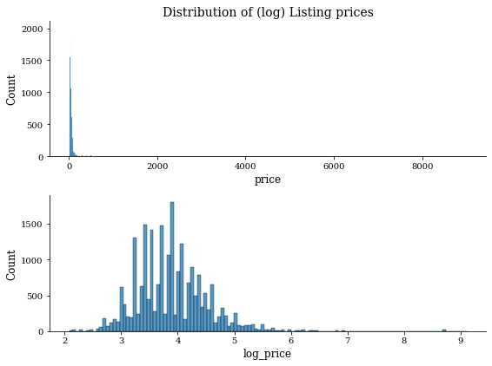
Target variable – ‘Price’
Description: Nightly price of the listing
'$160.00’, $1,000.00, ...
Steps
Remove ‘$’ and ‘,’ characters
Convert from string to number
Remove 9 listings with price <= 1
Add log_transformed version of the variable

Slide 10
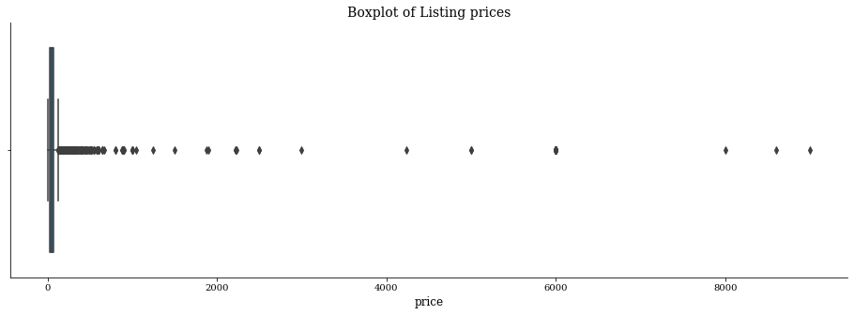
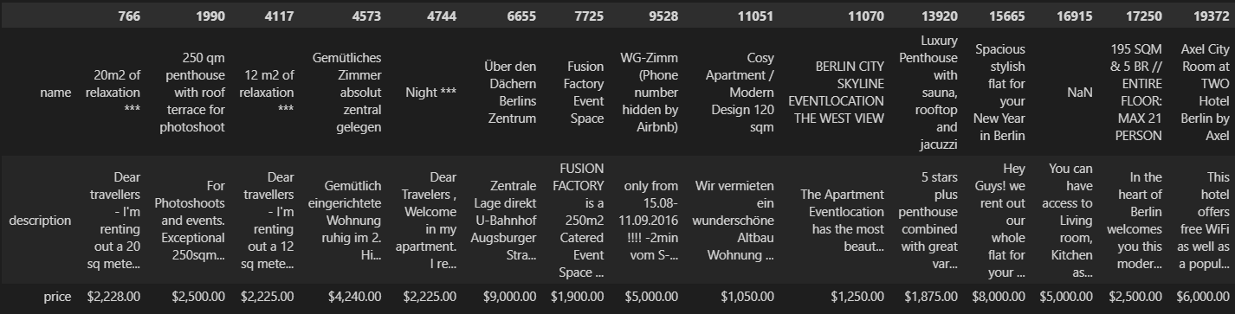
Checking extreme outliers
Based of boxplot: check how many > $1000
37 (i.e., top 0.16%)
Manually check for patterns/errors in these rows
Insights
Hotel Axel listing = Faulty
Luxury listings
Event locations
Still questionable listings, not enough info to truly know whether faulty (e.g., $2,225.00 for 12 m²)
We remove only Hotel Axel outliers (20 out of 37 rows)

Slide 11
Feature – amenities
Description: additional features in the property
'{TV,"Cable TV",Wifi,Kitchen,Gym,Heating,"Family/kid friendly","Smoke detector",Essentials,Shampoo,"Lock on bedroom door",Hangers,"Hair dryer",Iron,"Laptop friendly workspace","Private living room",Bathtub,"Hot water","Bed linens","Extra pillows and blankets",Microwave,"Coffee maker",Refrigerator,Dishwasher,"Dishes and silverware","Cooking basics",Stove,"Luggage dropoff allowed","Long term stays allowed"}’
Steps
Extract all unique features in the amenities column --> From Raw string to python set
Drop features which we expect to have no predictive value
i.e., Shampoo, Hangers
Group similar features under the same name
i.e., Pets, pet, Cat(s), Dog(s), Pets allowed, Pets live on this property, Other pet(s)’ → pets_allowed
Create binary columns for each remaining feature {1=has feature, 0=does not have feature}

Slide 12
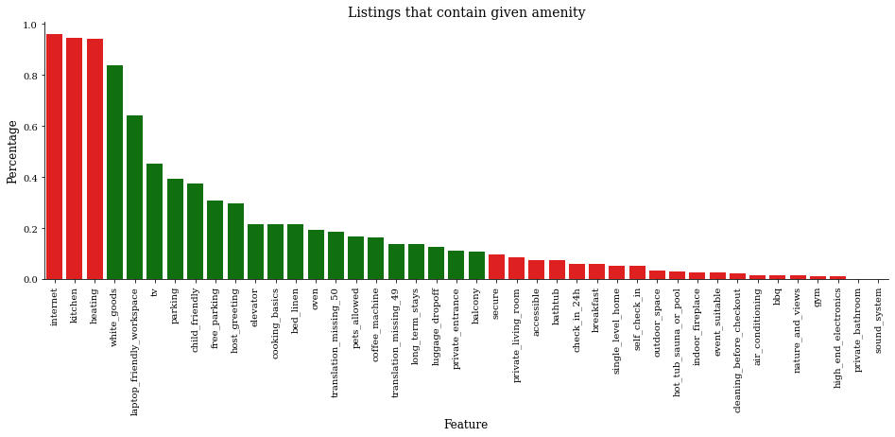
Feature – amenities
We COULD Remove features with huge imbalance of {1,0}: Rule of thumb 90/10 ratio = remove. I did not, model will filter out features later based on feature importance.

Slide 13
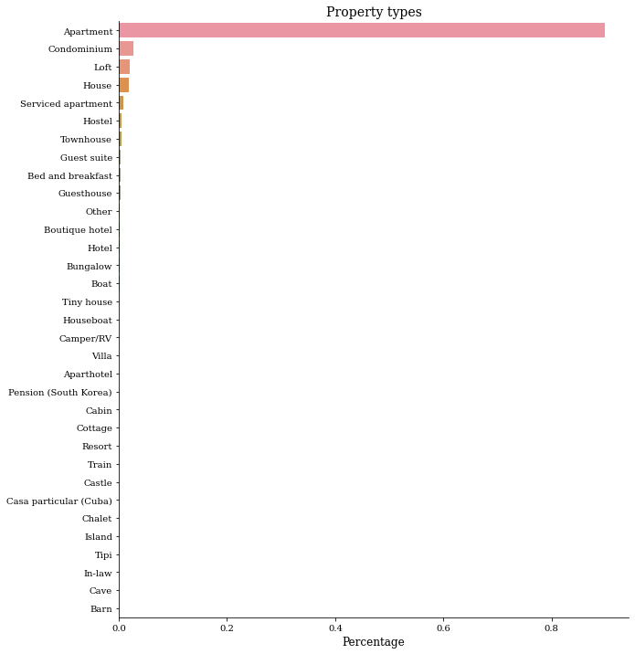
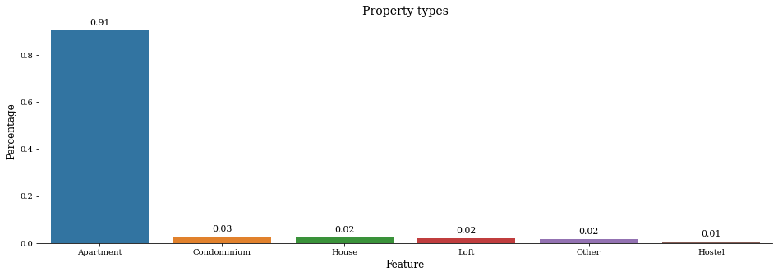
Feature – Property_type
Steps
Group categories together
One-hot-encode

Slide 14
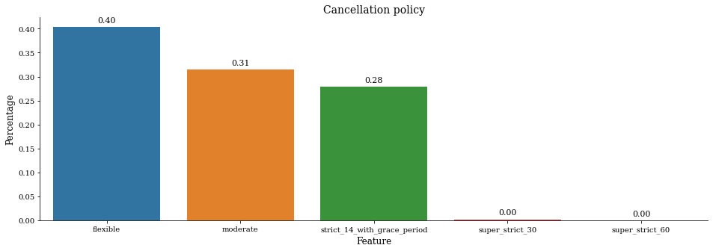
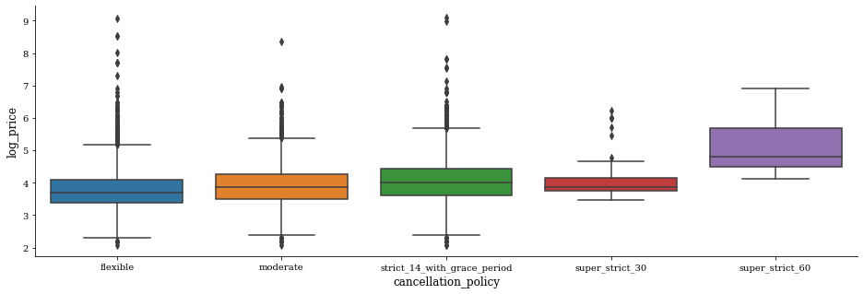
Feature – Cancelation_policy
Steps
Ordinal encoding

Slide 15
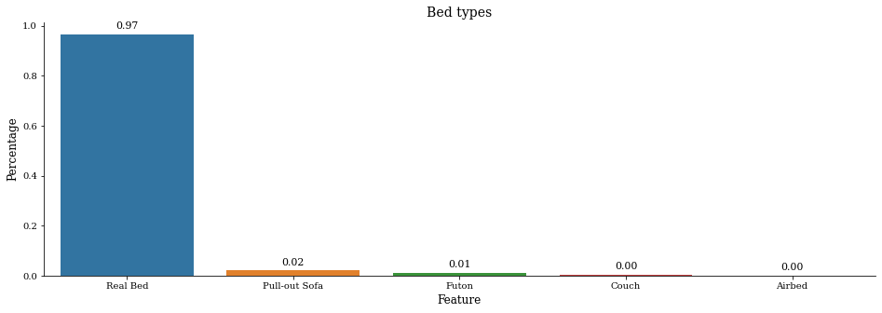
Feature – Bed_type
Steps
Drop

Slide 16
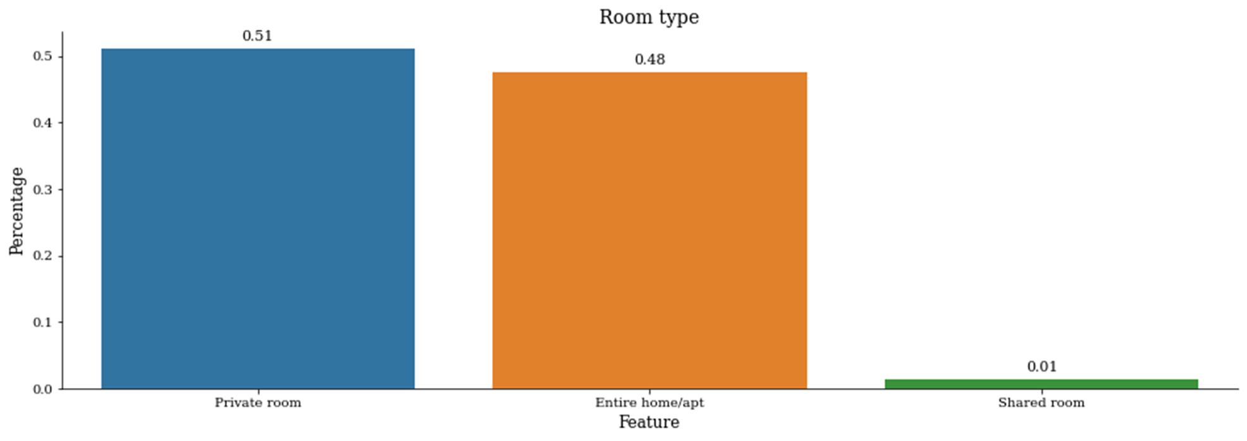
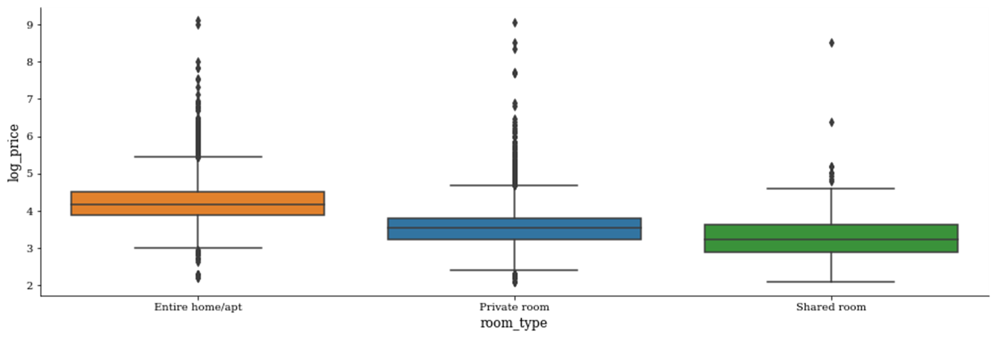
Feature – Room_type
Steps
Ordinal encoding

Slide 17
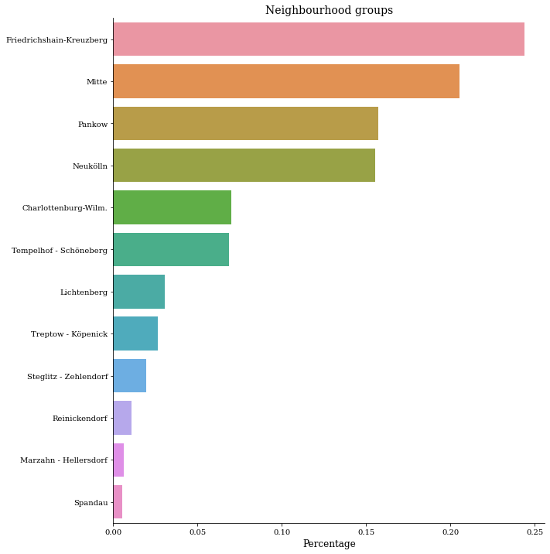
Feature(s) – neighbourhood
encode
"neighbourhood_group_cleansed“, "neighbourhood_cleansed“
Steps
One hot encode both columns.

Slide 18
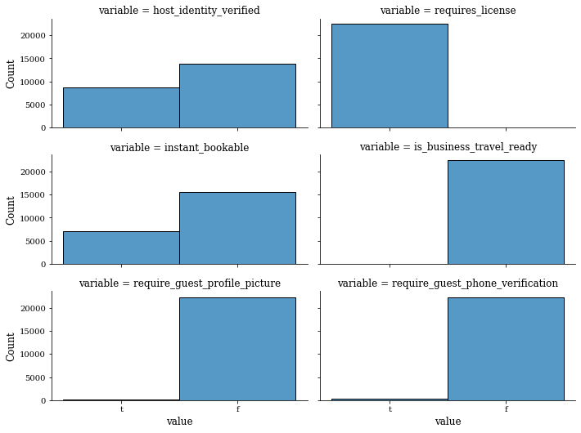
dichotomous Features
Steps
Remove features with huge class imbalance:
‘Requires_license’,'is_business_travel_ready',‘require_guest_profile_picture’,‘require_guest_phone_verification’
Map classes of remaining features to binary {t=1, f=0}

Slide 19
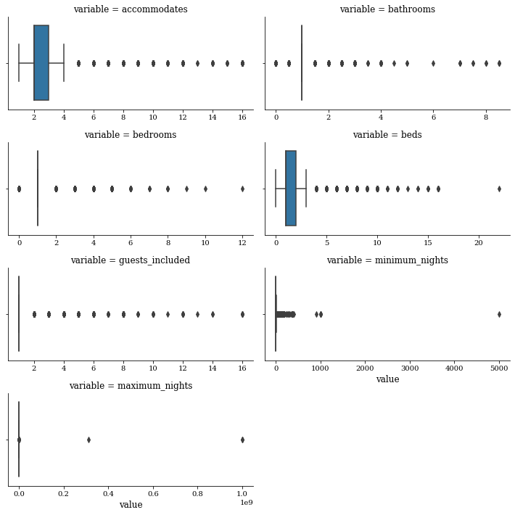
Numerical features
Steps
Leave as is.
No need to handle outliers (see max/min nights) as randomforest is not affected by outliers in features

Slide 20
Feature engineering
'distance_to_city_center’
Distance (in Km) from berlin city centre to the listing location, calculated based on latitude and longitude

Slide 21
Data Exploration

Slide 22
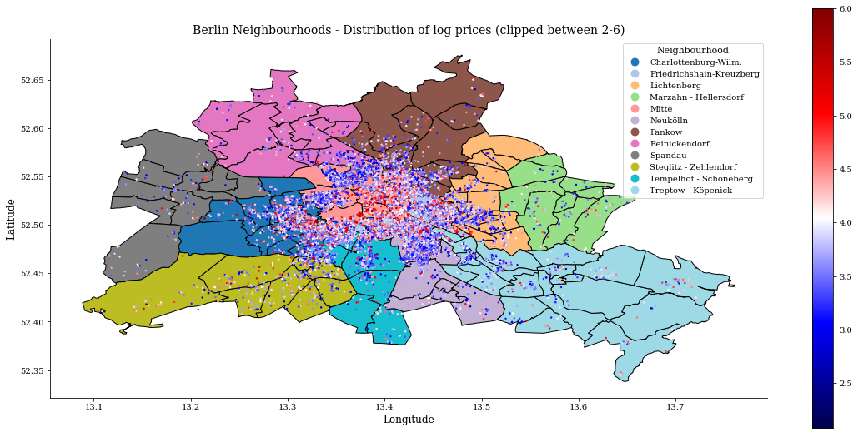
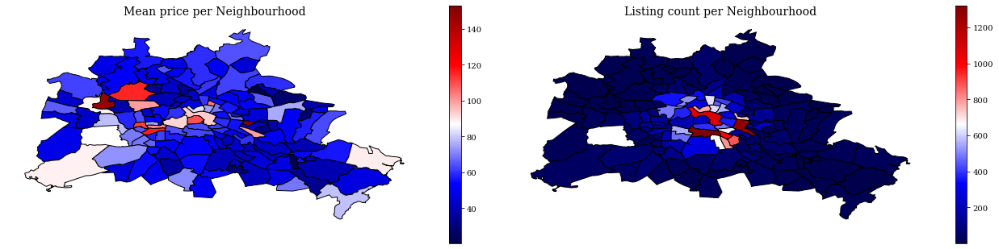
Log Price versus Listing location
Looks like prices in central berlin contain most of the expensive listings

Slide 23
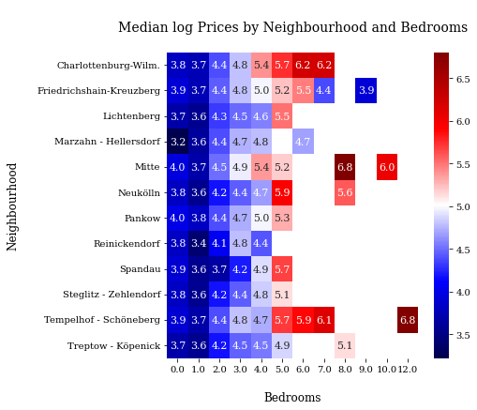
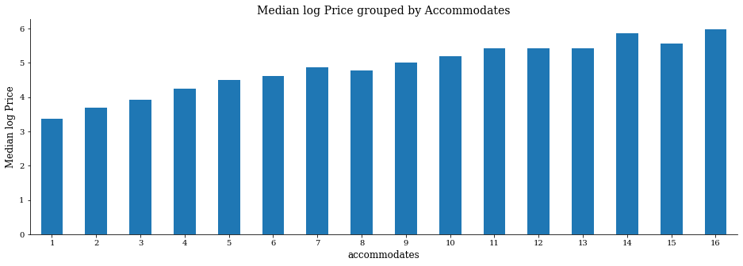
Log Price versus …

Slide 24
Modeling
RandomForestRegressor

Slide 25
Feature input for model
Feature Data shape - Just Before pre-processing :(22552, 26) --> After:(22523, 210)
Largest increase in columns due to 'neighbourhood_cleansed', 'neighbourhood_group_cleansed’ and `aminities` one-hot-encoding.
Features
'host_identity_verified', 'latitude', 'longitude', 'room_type', 'accommodates', 'bathrooms', 'bedrooms', 'beds', 'price', 'guests_included',
...
'neighbourhood_group_cleansed_Spandau', 'neighbourhood_group_cleansed_Steglitz - Zehlendorf', 'neighbourhood_group_cleansed_Tempelhof - Schöneberg', 'neighbourhood_group_cleansed_Treptow - Köpenick', 'property_type_Apartment', 'property_type_Condominium', 'property_type_Hostel', 'property_type_House', 'property_type_Loft', 'property_type_Other']

Slide 26
Train-Test split
Split 80/20
Feature shapes
Train: (18018, 210)
Test: (4505, 210)
Target shapes
Train: (18018,)
Test: (4505,

Slide 27
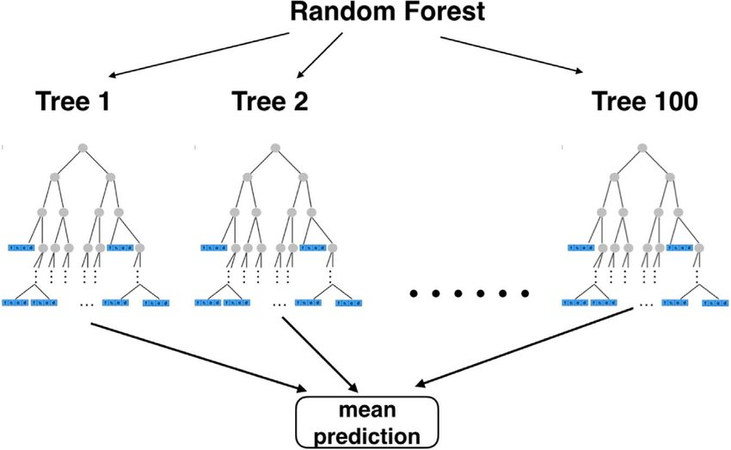
RandomForestRegressor

Slide 28
Why (not) RF regression?
Pros
Cons
Random forests are extremely useful to model complex non-linear data.
For example, the price vs the combination of latitude and longitude
Accuracy of Random forest is generally very high
Does not overfit with more features (unlike most other models)
It is non-parametric by design meaning that it requires very few underlying assumptions in the data
Gives a measure of feature importance that we can use for additional feature selection
Can’t extrapolate outside unseen data
Black box(-ish)

Slide 29
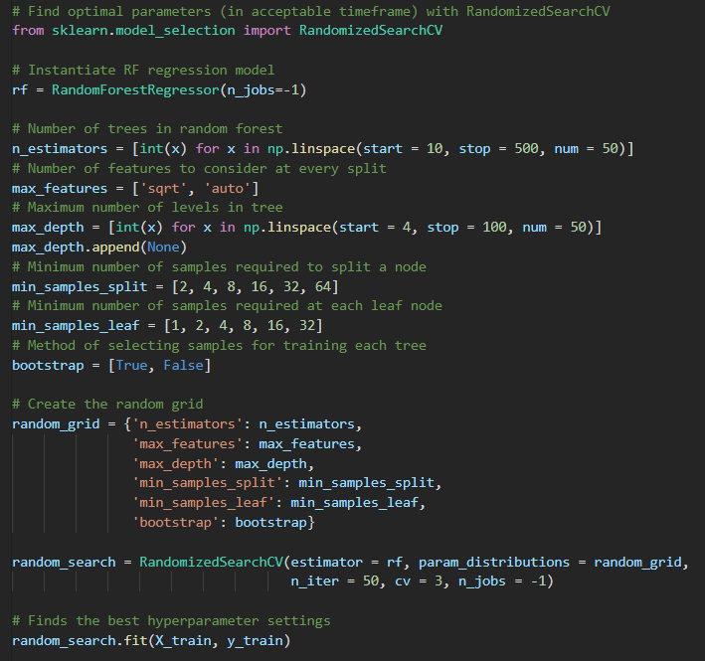
Hyperparameters
RandomizedSearchCV for finding the ‘best’ hyperparameters
opt_params = {'n_estimators': 460, 'min_samples_split': 8, 'min_samples_leaf': 1, 'max_features': 'sqrt', 'max_depth': 58, 'bootstrap’: True}

Slide 30
Initial Evaluation

Slide 31
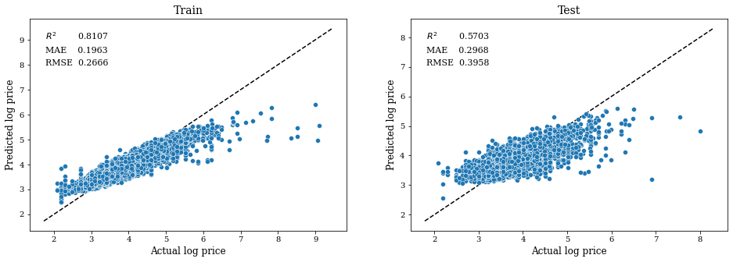
Initial Evaluation
Let's not dive to deep into the evaluation meaning for now…

Slide 32
Feature selection (2)
Feature importance

Slide 33
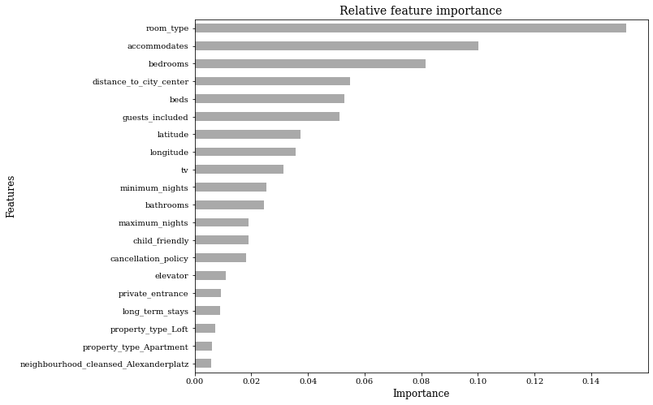
Feature Selection (2)
Select Top K(=20) most important features according to the fitted model

Slide 34
Final Evaluation
Refit model based on top K features

Slide 35
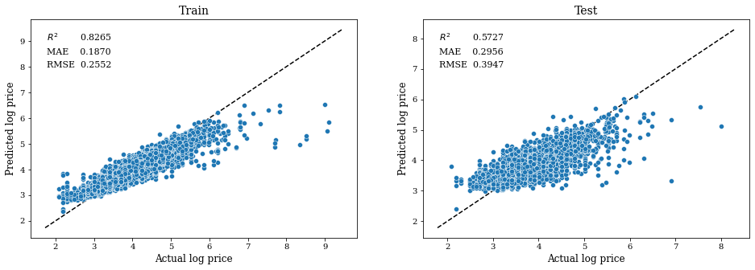
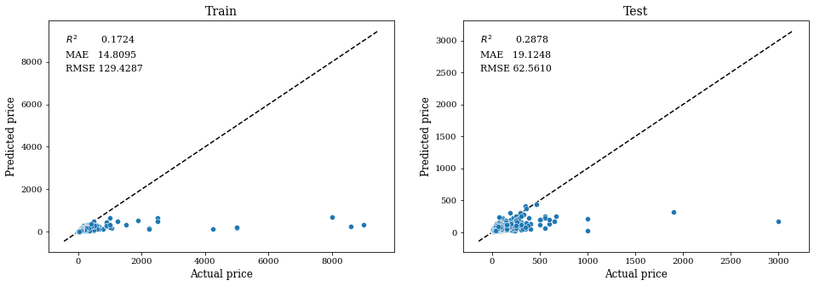
Final Evaluation
Notice the impact of influential outliers on the coefficient of determination
Accuracy
48.72% < $10.00
76.38% < $20.00
86.57% < $30.00

Slide 36
Future Steps

Slide 37
How could we improve the predictions?
Apply NLP on the dropped Text columns
"summary","space", "description", "name", "neighborhood_overview", "notes", "transit", "access", "interaction", "house_rules"
Extract keywords
I noticed a lot of square feet in ‘description’ whilst the ‘square_feet’ column was NaN, we can try to extract these values (in an accurate/reliable manner)
Extract sentiment scores from ‘description’ or ‘summary’
Better grouping of small ‘property_type’ categories instead of grouping them all as ‘other’
Add different models (e.g., XGboost) and use an aggregated prediction
As Airbnb: enrich amenities column

